Slide 1
DATA SCIENCE FOR ECONOMISTS
ECON 220 LAB
Jafet Baca-Obando
Week 12, Analysis of Variance – 11/14/2025

Slide 2
Outline
01 | ANOVA
02 | Hypothesis for ANOVA
03 | Tukey’s HSD

Slide 3
What is ANOVA?
Stands for Analysis of Variance
Used to compare means(averages) across more than two independent groups.
More interesting questions:
  Example: Do average earnings differ across education levels?

Slide 4
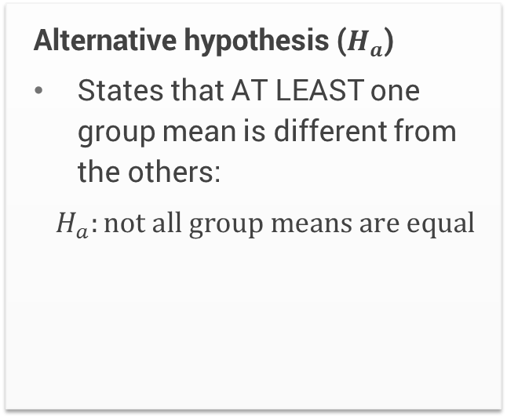
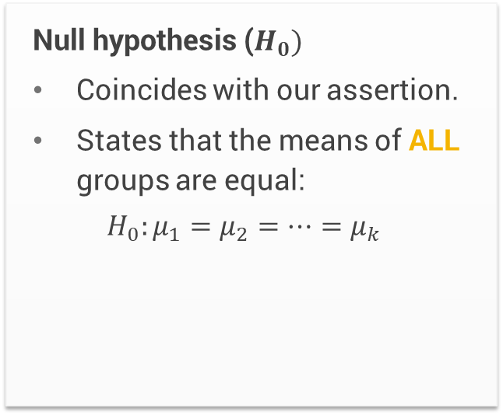
The hypothesis for ANOVA
Null hypothesis ($H_{0})$
Coincides with our assertion.
States that the means of ALL groups are equal:
$$H_{0}:μ_{1}=μ_{2}=⋯=μ_{k}$$
Alternative hypothesis ($H_{a}$)
States that AT LEAST one group mean is different from the others:
$H_{a}:not all group means are equal$

Slide 5
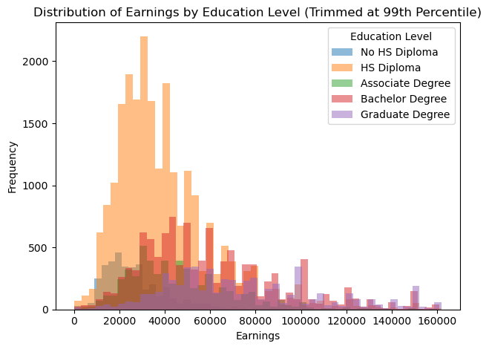
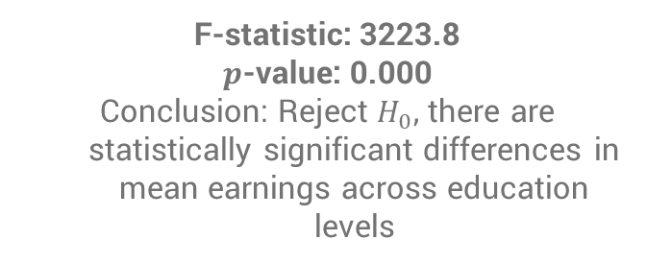
Example: Earnings by education level
F-statistic: 3223.8
$p$-value: 0.000
Conclusion: Reject $H_{0}$, there are statistically significant differences in mean earnings across education levels

Slide 6
To-do list
Complete Data Exercise 8
  Upload Jupyter notebook (.ipynb file) and HTML file on November 16
Complete Data Exercise 9
  Upload Jupyter notebook (.ipynb file) and HTML file on November 23

